Slide 1
Modernization Traffic Monitoring System
Group 3

Slide 2
OUTLINE
Group Members’ introduction and job allocation
Product show
Technique
Summary

Slide 3
Group Members’ work introduction
PM :
10301016 刘子渊
Group member :
10301156 李韵涵
10301107 王馨迪
10301077 魏善源
10301063 李菊琛

Slide 4








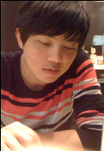
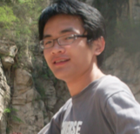
李韵涵
Client end
Server end
李菊琛
刘子渊
Recognition
王馨迪
魏善员

Slide 5
tools
Qt creator
Matlab
Sqlite

Slide 6
technique
Connect client and server using tcp socket
Manage related data about cars and drivers using sqlite database
Recognition module:
Locate, Cut, Match

Slide 7
Summary. Achievements
High security
High user experience
Finish basic function of the project

Slide 8
Summary. Drawback
Could not recognize all kinds of pictures
Program running time is a bit too long
Have not managed the project progress well

Slide 9
Product show

Slide 10
Thanks!
To my group member And Ms. Wan!

